Slide 1
SUFFIX TREE
CONTENTS OF THIS PPT:-
TRIE
COMPRESSED TRIE
SUFFIX TREE

Slide 2
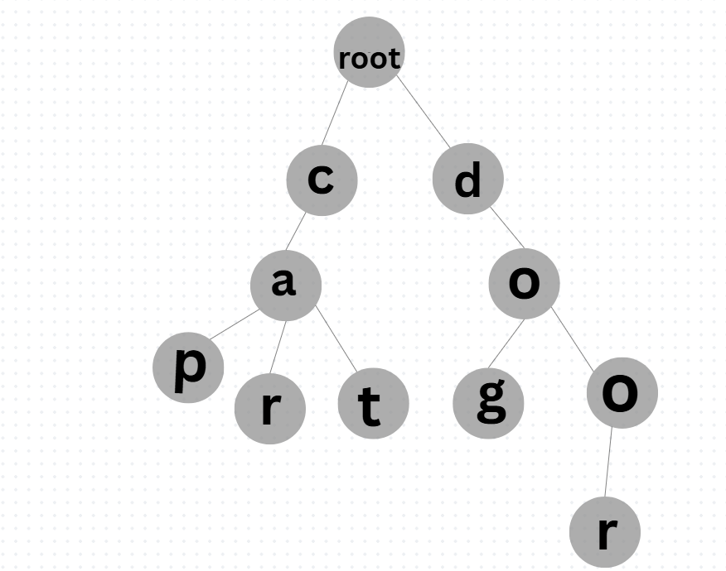
A suffix tree is a compressed trie for all the suffixes of the text. So first you have to know that what is Trie and what is Compressed Trie.
TRIE
-Trie is an ordered tree to maintain a set of strings.
Example:-
Text: cat , cap, dog, door

Slide 3
Explanation of Trie :-
Each and every node will be a structure, called TRIENODE.
Each node having a character called DATA.
Each node has pointers to the children(maximum 26 pointers allowed).
Each node have an array of pointers.
We use $ symbol to indicate the end of the word .

Slide 4
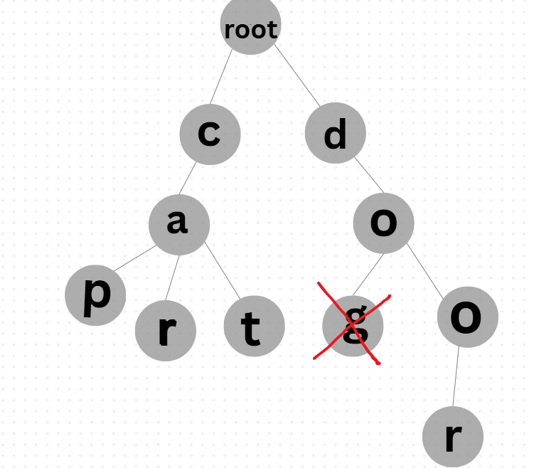
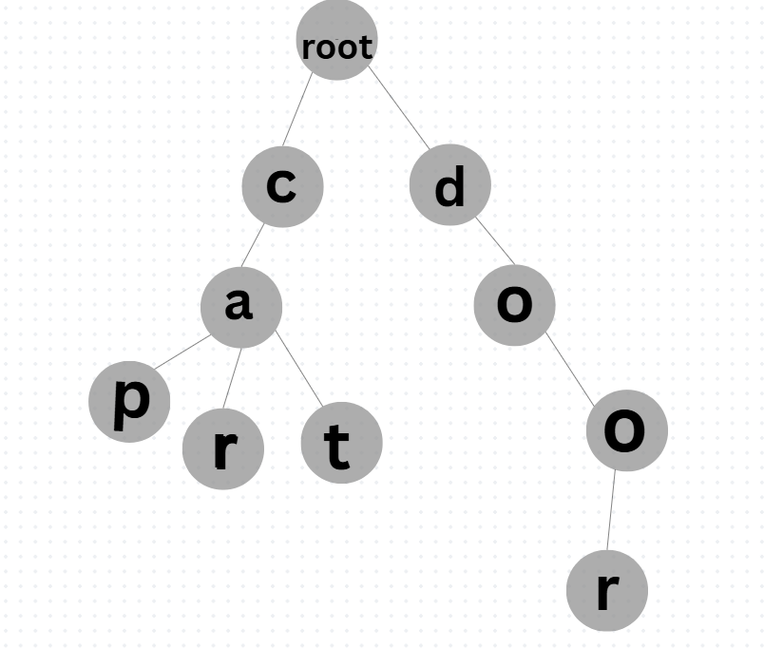
Deletion In trie :-
Delete DOG:-
Just delete the node containing ‘g’ , if the parent of ‘g’ doesn’t contain another child , we can delete the parent also . But here parent ‘o’ has another child ‘o’ , ie, there is another word containing ‘o’.
Now the word dog deleted here.

Slide 5
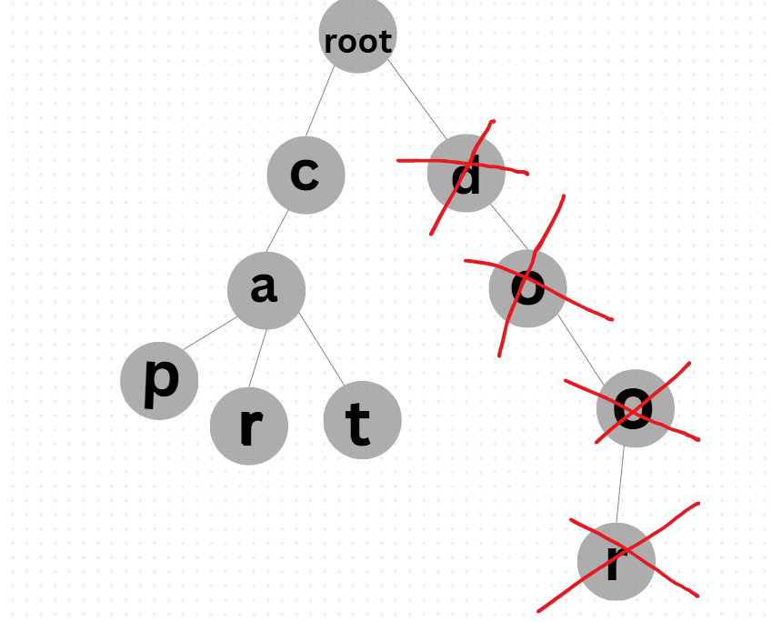
Delete DOOR:-
We can delete the nodes ‘r’ and ’o’(o has no another child),also ‘o’ , ’d’, because there is no another child for parent of each.
Now we delete the word Door.

Slide 6
Ok , now we understand the deletion and insertion operation in trie. The Time complexity of insertion and deleteon is O(m) .
But, Space complexity is O(n), if we said trie is an efficient way to store strings ,we have to consider time and space complexity . So that’s why we use COMPRESSED TRIE.
COMPRESSED TRIE
A compressed trie is a standard trie in which each and every node except leaf node has atleast two children .
Example:-
Text:- code, complex, compile, run

Slide 7
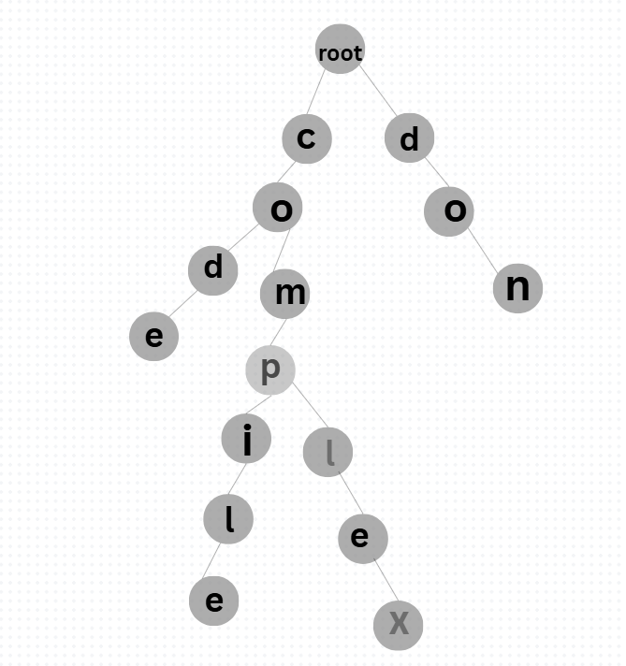
STANDARD TRIE
Notes:
STANDARD TRIE

Slide 8
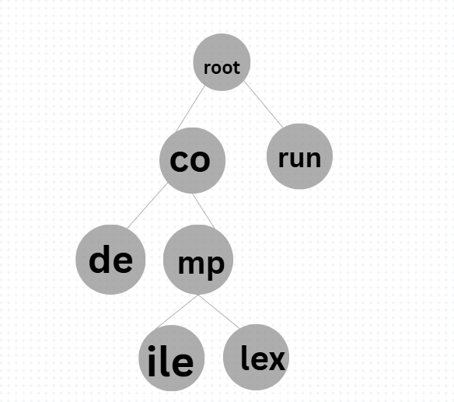
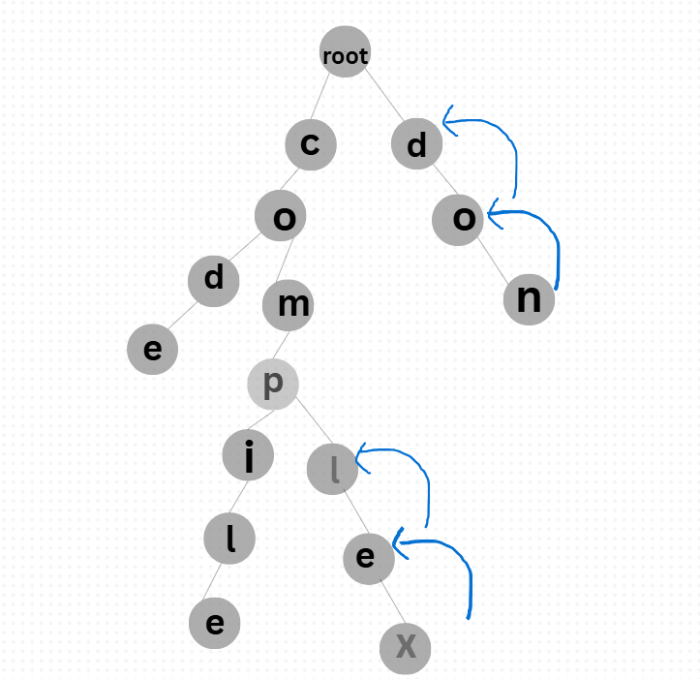
COMPRESSED TRIE
Explanation of compressed trie:-
Merge the nodes into one, if nodes having single children .
Repeat until a node having 2 children.
Notes:
COMPRESSED TRIE

Slide 9
Ok now get back into SUFFIX TREE
A suffix tree ia a compressed trie for all the suffixes of the text
Example:-
Text:-banana
Suffix 1: banana
Suffix 2:-anana
Suffix 3:-nana
Suffix 4:-ana
Suffix 5:=na
Suffix 6:-a

Slide 10
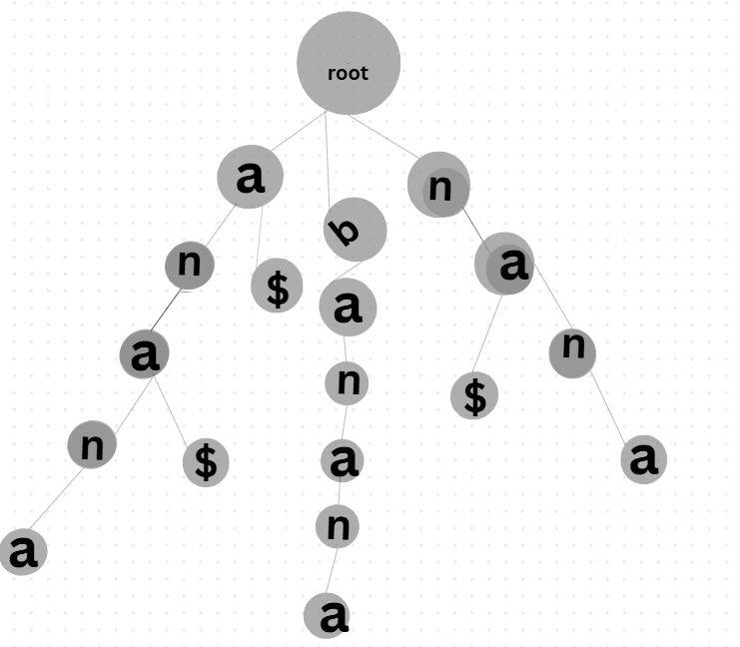
Standard trie of suffixes:-

Slide 11
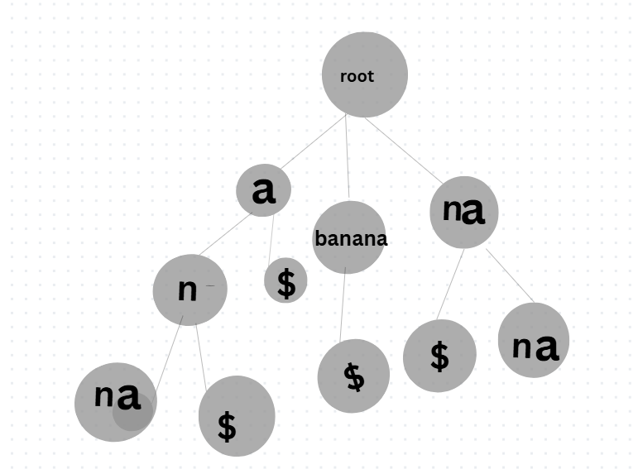
Compressed trie of suffixes:-
here is SUFFIX TREE …….

Slide 12
Reference link from you tube:-
TRIE :- https://youtu.be/KJVQeyLQKbc?si=fchOu3xDpWqV3ExW
COMPRESSED TRIE:- https://youtu.be/ASWUw5EeMdo?si=FOSOlLQE6oiaQsIB
SUFFIX TREE:- https://youtu.be/Yt0t_Diqp1o?si=Kbv4AgKKZoPaT3t-
DOT

